Slide 1

C:/users>cool_dudes> NATURAL LANGUAGE PROCESSING
HARSHIL SHAH

Slide 2
THE BIGGEST QUESTION – WHAT IS Nlp!!
Natural language processing (NLP) is a subfield of computer science, information engineering, and artificial intelligenceconcerned with the interactions between computers and human (natural) languages, in particular how to program computers to process and analyze large amounts of natural language data.

Slide 3
NOTHING COMPLICATED -
ITS JUST FOUR STEPS –
Creepily acquire data from the vast amount of internet users without asking them
Clean that data (not by using a broom obvio)
Convert it into mathematical representations coz computers aint smart as you
THE FINAL STEP- USE LAWS OF PROBABLITIES AND SOME REALLY COOL SOUNDING MODELS TO GENERATE STORIES OR UNDERSTAND HUMAN EMOTION

Slide 4

WHATS SO IMPORTANT ABOUT NLP !!
PROVIDING SOME CONTEXT =>Humankind produces in two days the same amount of data it took from the dawn of civilization until 2003 to generate
682 million tweets per day
293 billion emails are sent daily in 2019,
Every minute on Facebook: 510,000 comments are posted, 293,000 statuses are updated, and 136,000 photos are uploaded.
The amount of data created with the increase in IOT and cheap data rates

Slide 5
SHOULD WE LET SO MUCH DATA AND INFORMATION GO TO WASTE!!
OR SHOULD WE TRY UNDERSTANDING ITS UNDERLYING PATTERNS AND USE IT !!

Slide 6

WHAT IS IT DIVIDED INTO
NATURAL LANGUAGE UNDERSTANDING
NATURAL LANGUAGE GENERATION
Voice User Interface

Slide 7
CHALLENGES IN NLP

Slide 8
TEXT CAPTURING
FEATURE EXTRACTION
MODELLING
TEXT PROCESSING

Slide 9
TEXT CAPTURING
ON A MACRO LEVEL
API of social media sites(Twitter,Reddit)
Web Scraping(Wikipedia)
Kaggle datasets
ON A MICRO LEVEL-
Nothing really available due to privacy issues

Slide 10
NORMALIZATION is a process that converts a list of words to a more uniform sequence
CASE NORMALIZATION
PUNCTUATION REMOVAL
WHY TO DO IT!!
useful in preparing text for later processing.
converting all words to lowercase will simplify the searching process
example--several ways that the term "modem router" can be expressed, e.g modem and router, modem & router, modem/router,. By normalizing these words to the common form, it helps increasing accuracy
WHY NOT TO DO IT!!
Understand that the normalization process might also compromise an NLP task. Converting to lowercase letters can decrease the reliability of searches when the case is important.

Slide 11
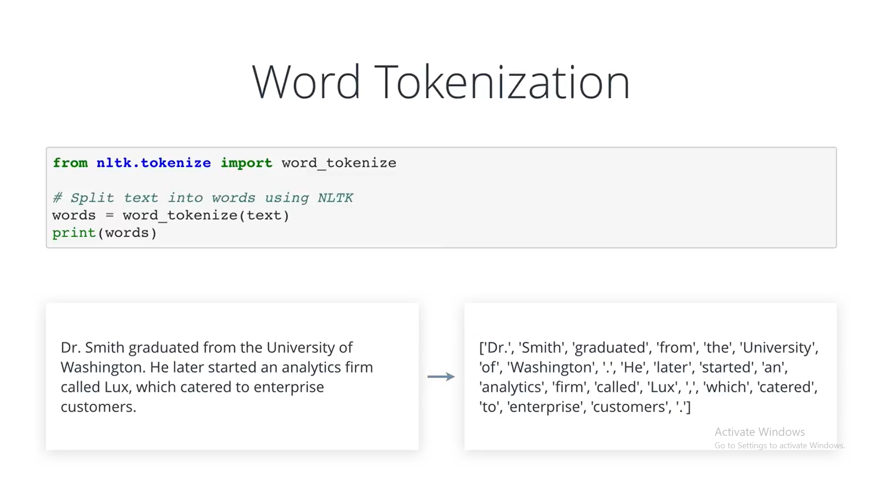
TOKENIZATION-makes the sentence into individual words
WORD TOKENIZATION
WHITESPACE TOKENIZATION-
Splits words after encountering whitespace
Txt.split()
Other Tokenization-
Tweeter Tokenization
Html tokenization

Slide 12
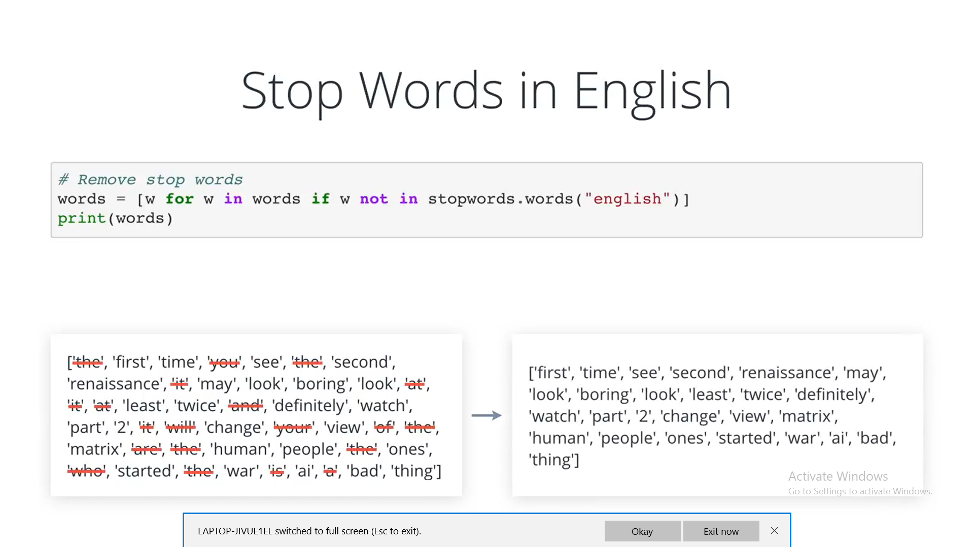

Slide 13
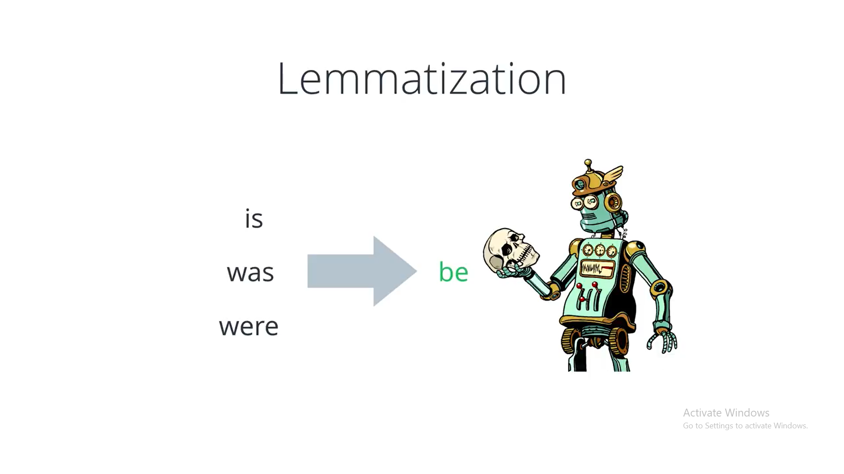
STEMMING AND LEMITIZATION–maps different instance of the word to its root word
STEMMING
LEMITIZATION
Uses simple rules
E.g-removes instances of ed,ing ,es,etc.
Used when model relies on the number of instances of the word and not entirely its structure
Uses different variance of the same word

Slide 14
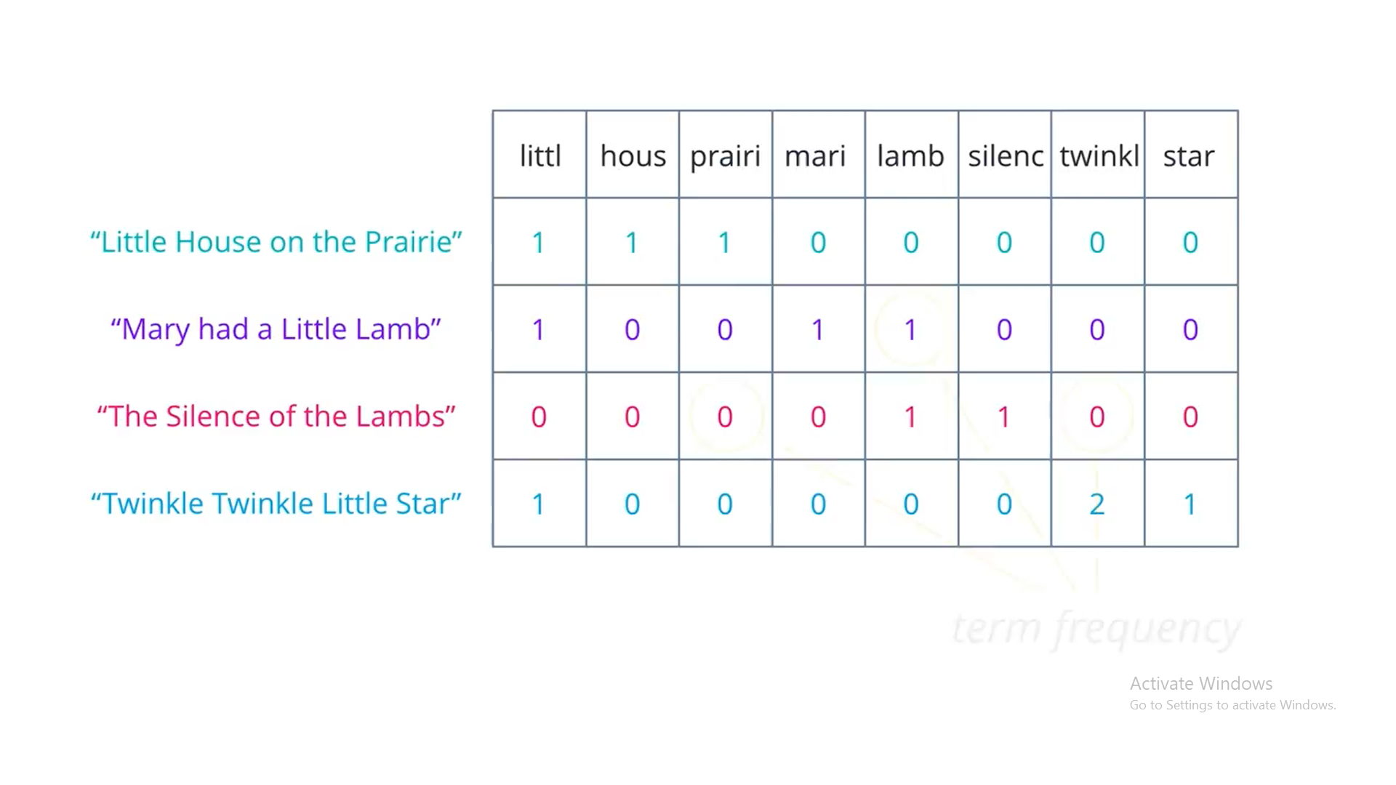

Slide 15
IN TIME FAR BEFORE…….I TOLD SOMETHING
WHAT WILL BE THE NEXT STEP??

Slide 16
FEATURE EXTRACTION

Slide 17
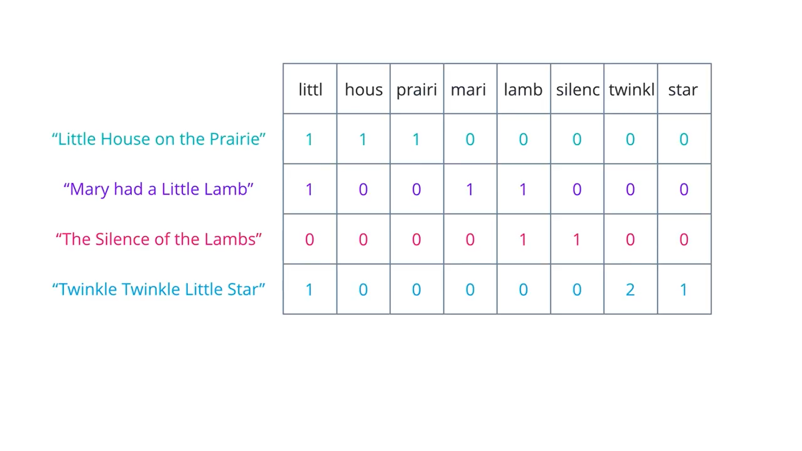
BAG OF WORDS
Bag of Words is a method to extract features from text documents. These features can be used for training machine learning algorithms. It creates a vocabulary of all the unique words occurring in all the documents in the training set. For example, if you have 3 documents-
First, it creates a vocabulary using unique words from all the documents -
Unique list of words -
I am feeling very happy today not well wish could go to play
Then, for each word the frequency of the word in the corresponding document is inserted
DOCUMENT TERM MATRIX

Slide 18
OTHER ALGORIHTMS
One Hot encoding
Word2Vec
WordEmbeddings
TF-ID

Slide 19
P.S-DONOT FORGET TO TAKE COURSE ON MACHINE LEARNING FROM ME
-REALLY ENJOYED HAVING A TALK WITH YOU GUYS !!!
DON’T FORGET TO SAY A HI WHEN WE BUMP AROUND THE CAMPUS

Slide 20
TILL THEN………….. SAYONARA
CONTACT-HARSHIL SHAH –ANYTIME BEFORE 1130 PM
-8879303958

